Slide 1
Lexicon based Approaches : Sentiment Analysis
K. Krishnakumari
406912051
NIT, Tiruchirappalli

Slide 2
ML Approach vs Lexicon Approach
Machine Learning Approach (ML) - ML algorithms and uses linguistic features.
Lexicon-based Approach - Sentiment lexicon, a collection of known and precompiled sentiment terms.
Dictionary-based approach and corpus-based approach which use statistical or semantic methods to find sentiment polarity.

Slide 3
Sentiment classification techniques
PMI, LSA
Wordnet+eWOM

Slide 4
Lexicon based method
Semantic orientation (SO) is a measure of subjectivity and opinion in text.
The lexicon-based approach involves calculating orientation for a document from the semantic orientation of words or phrases in the document (Turney 2002).
Dictionaries for lexicon-based approaches can be created manually or automatically using seed words to expand the list of words.
First, a list of adjectives and corresponding SO values is compiled into a dictionary. Then, for any given text, all adjectives are extracted and annotated with their SO value, using the dictionary scores. The SO scores are in turn aggregated into a single score for the text.

Slide 5
Problems
Simulating the effect of linguistic context - negation (e.g., not good) and intensification (e.g.,very good)

Slide 6
Thumbs Up or Thumbs Down? Semantic Orientation Applied to Unsupervised Classification of Reviews

Slide 7
Semantic Orientation CALculator (SO-CAL)
First extract sentiment-bearing words (including adjectives, verbs, nouns, and adverbs)
Use them to calculate semantic orientation, taking into account valence shifters (intensifiers, downtoners, negation, and irrealis markers).
Assumption: Prior polarity, that is, a semantic orientation that is independent of context; and semantic orientation can be expressed as a numerical value.

Slide 8
Adjectives
Primary source of subjective content in a document.
The SO of an entire document is the combined effect of the adjectives or relevant words found within, based upon a dictionary of word rankings (scores).
Dictionary
Manually, using existing dictionaries such as the General Inquirer
Semi-automatically, making use of resources like WordNet or SentiwordNet.
Automatically via association.
Simple aggregate-and-average method:
The individual scores for each adjective in a document are added together and then divided by the total number of adjectives in that document

Slide 9
Nouns, Verbs, and Adverbs
strolled+ purposefully => positive
strutted− cockily− => negative
Intensification
Amplifiers (e.g., very) increase the semantic intensity of a neighboring lexical item.
Downtoners (e.g., slightly)
irrealis markers includes modals, conditional markers (if ), negative polarity items like any and anything, certain (mostly intensional) verbs (expect, doubt).

Slide 11
Dictionary based Approach
Sentiwordnet
First sense method: SO(w) = 5 × (Pos( f ) − Neg( f ))
For the averaging across senses method,
the difference between the positive and negative scores provided by SentiWord-Net (each in the 0–1 range), averaged across all word senses for the desired part of speech, and multiplied by 5 to provide SO values in the −5 to 5 range.

Slide 12
A Holistic Lexicon-Based Approach to Opinion Mining
The main idea is to use the opinion words around each product feature in a review sentence to determine the opinion orientation on the product feature.
The key difficulties are:
how to combine multiple opinion words (which may be conflicting) to arrive at the final decision,
how to deal with context or domain dependent opinion words without any prior knowledge from the user, and
how to deal with many important language constructs which can change the semantic orientations of opinion words.

Slide 15
SentiRelated: a Cross-Domain Sentiment Classification Algorithm for Short Texts through Sentiment Related Index -Lei Wang, Jianwei Niu, Houbing Song, Mohammed Atiquzzaman (1)
Sentiment Related Index(SRI) to measure the association between different lexical elements in a specific domain with the help of domain-independent features as a bridge.
Two sentiment lexicons
HowNet - http://www.datatang.com/data/12990
NTUSD - http://www.datatang.com/data/44317
Choose the features that used more than K times in both domains.

Slide 16
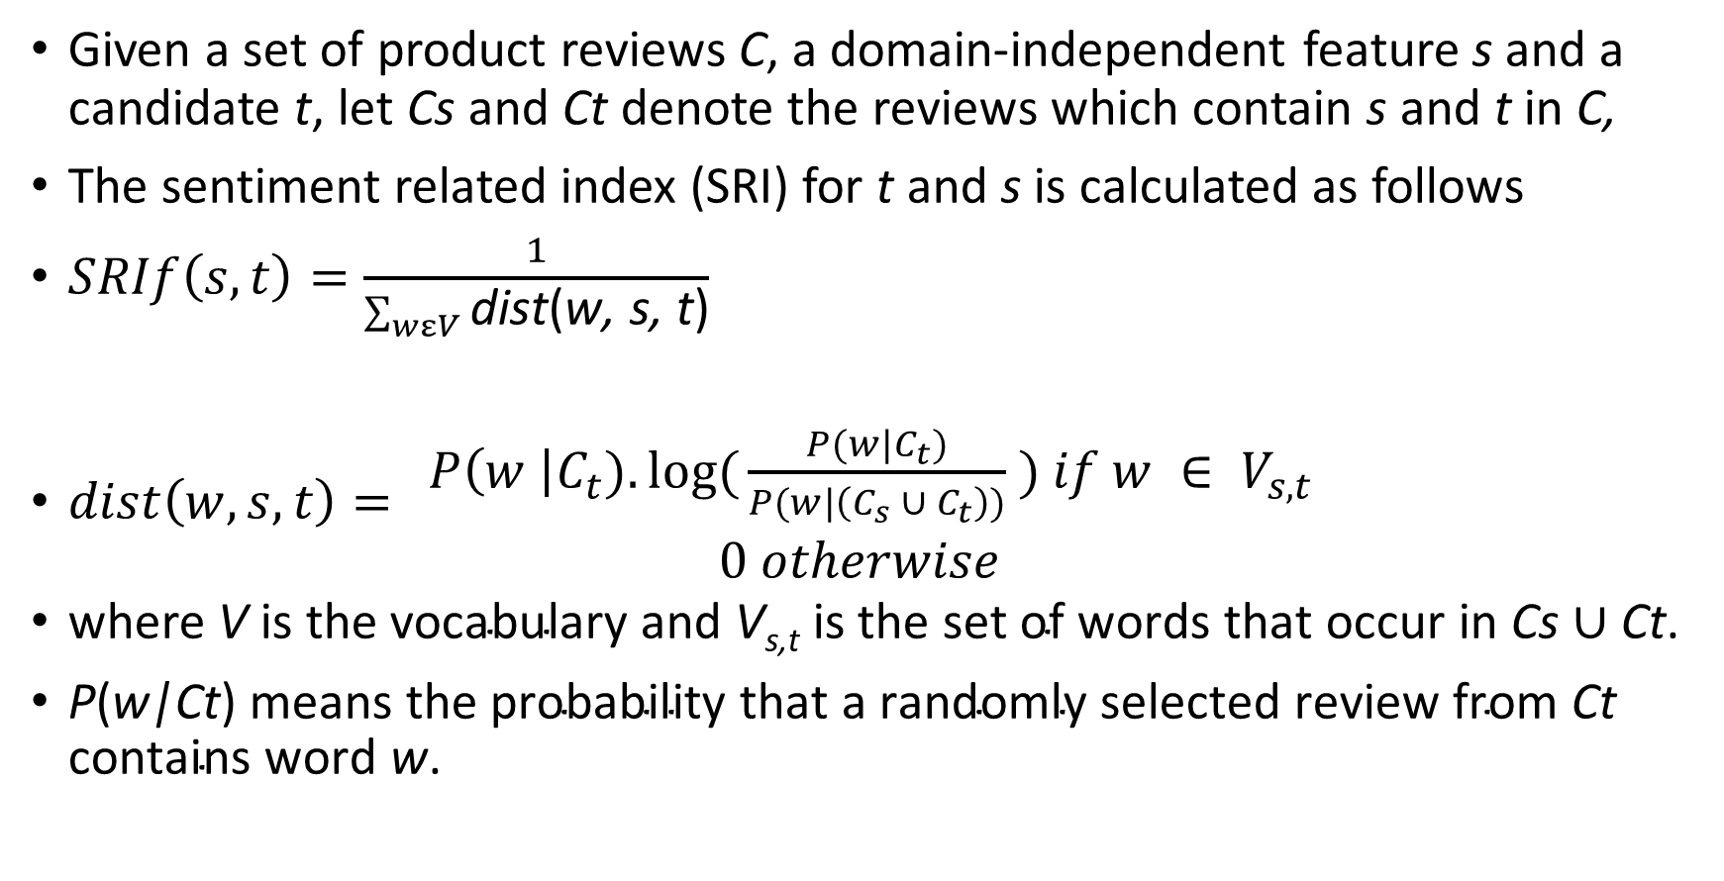
Sentiment related index (SRI)
Given a set of product reviews C, a domain-independent feature s and a candidate t, let Cs and Ct denote the reviews which contain s and t in C,
The sentiment related index (SRI) for t and s is calculated as follows
$SRIf\left(s,t\right)=\frac{1}{\sum_{wεV}{\text{dist}\text{(}\text{w}\text{, }\text{s}\text{, }\text{t}\text{)}}}$
$dist\left(w,s,t\right)=$ $\begin{matrix} P\left(w \right|C_{t}).log({\frac{P(w|C_{t})}{P(w|\left(C_{s} ∪ C_{t}\right))}} ) if w ∈ V_{s,t} \\ 0 otherwise\end{matrix}$
$\text{where} \text{V} \text{is} \text{the} \text{vocabulary} \text{and} \text{V}\text{s}\text{,}\text{t} \text{is} \text{the} \text{set} \text{of} \text{words} \text{that} \text{occur} \text{in} \text{Cs}∪\text{C}\text{t}\text{.}$
$\text{P}\text{(}\text{w}\text{|}\text{Ct}\text{) }\text{means} \text{the} \text{probability} \text{that} \text{a} \text{randomly} \text{selected} \text{review} \text{from} \text{Ct} \text{contains}$ $\text{word} \text{w}\text{.}$

Slide 17
Ranking Score
Ranking Score is given by
where ri = tf (wi) ・ tf (u), and tf (wi) and tf (u) denote the number of times that terms wi and u occur in the unlabeled reviews on target domain, respectively.

Slide 19
A novel sentiment aware dictionary for multi-domain sentiment classification
The main challenges involved are as follows:
1. It should be identified correctly that which features of the source domain are similar to which features of the target domain.
2. It should have a learning structure like a dictionary to accommodate the knowledge about the relatedness of the features from the source and target domains for the classification of target domain features.

